Slide 1
Identity & Access Mgmt
Who has access to your cloud resources?
Alexandre Fagundes
LAD Partner Enablement

Slide 2
Agenda
IAM: What is?
How it works
Identity Concepts
Policies syntax and advanced policies
Compartments
Concept of Policy Inheritance and Attachment
Free form tags, defined tags and TBAC
Understand Multi-Factor Authentication (MFA)
Users Federation
Design reference IAM Model for an Enterprise
Real life story for IAM compartment and policy design

Slide 3
What is OCI IAM?
Fine-Grained Access Control
Who can access certain data?
Auditing
What did you do?
AuthZ
What permissions do you have?
AuthN
Who are you?
Identity and Access Management (IAM) service
Controls what type of access
a Group of users have and to…
...which specific resources

Slide 4
How it works?
IAM uses traditional identity concepts such as Principals, Users, Groups, Dynamic Groups, AuthN, AuthZ and introduces a new capability called Compartment
OCI IAM
Identities
(Who requests)
Permissions
(what is requested by the Identity)
Compartments
Policies
Groups
Instance
Resources (Cloud Objects)
Users
Notes:
Identity and Access Management Service (IAM) enables you to control who can do what in your OCI account
IAM service Principals – Users/Groups, Instance Principals
Authentication done through username/password and API Signing Keys
Authorization done by defining specific privileges in Policies and associating them with Principals
Policies are comprised of one or more human-readable statements which specify what groups can access what resources and what level of access users in that group have
Compartment, a unique OCI feature, can be used to organize and isolate related cloud resources
OCI supports both free form tags and defined tags with a schema and secured by policies
OCI Audit Service Automatically records calls to OCI services API endpoints as log events

Slide 5
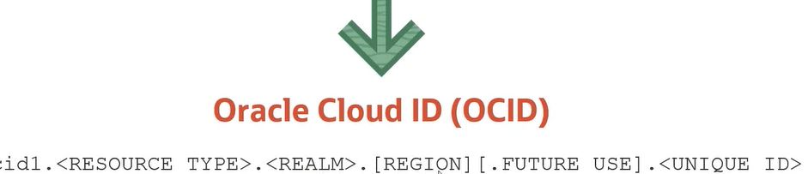
Resource is nothing but a cloud object!
Resource is a cloud object that you create and use in OCI (e.g. compute instances, block storage volumes, Virtual Cloud Networks)
Each OCI resource has a unique, Oracle-assigned identifier called an Oracle Cloud ID (OCID)

Slide 6
Identity Concepts

Slide 7
Principals
A principal is an IAM entity like users and Instance Principals that is allowed to interact with OCI resources
Instance Principals lets instances (and applications) to make API calls against other OCI services removing the need to configure user credentials or a configuration file
IAM Users, Groups, Dynamic Groups
Users are persistent identities setup through IAM service to represent individual people or applications
When customers sign-up for an OCI account, the first IAM user is the default administrator
Default administrator sets up other IAM users and groups
Users enforce security principle of least privilege
- User has no permissions until placed in one (or more) groups and
- Group having at least one policy with permission to tenancy or a compartment
Group is a collection of users who all need the same type of access to a particular set of resources
Same user can be member of multiple groups

Slide 8
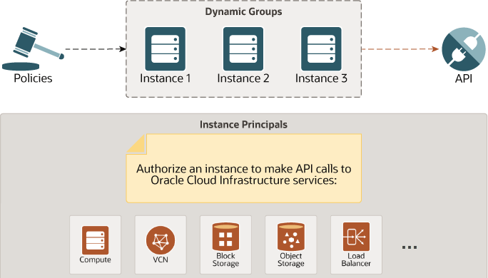
Dynamic Groups
Allows principals to be grouped as “principal actors” (similar to a group of users)
Membership changes (e.g., scale instances up & down)
Dynamic Groups relies on Matching Rules
Notes:
Instance Configurations
Define the configuration information to launch a Compute instance
Include parameters (OS image, metadata, shape) and related resources as a single configuration entity, so you don’t have to specify them every time you launch a new instance
Configure attached storage volumes; VNIC, Subnets and AD placements all with a single request
Instance Pools
Provision and create multiple compute instances based off of the same instance configuration, within the same region
Scale up/down
1 pool:1 configuration, but 1 configuration: n pools
Instance Pools are a building block needed to implement Auto-Scaling
An Instance Configuration is a template that defines a set of required and optional parameters needed to create a compute instance on Oracle Cloud Infrastructure, including OS image, shape and resources, such as block volumes attached to the instance as a single configuration entity. You can create an Instance Configuration from an existing running instance or construct a custom Instance Configuration via the CLI. When Boot or Data storage Volumes do not already exist, these resources will automatically be created for you when launching an instance. With one single action, you can launch an instance, we create storage volumes, attach VNIC's and stripe the set number of Instances evenly across the desired availability domains (AD's) for you. This is something that would normally require manual provisioning of each individual resource on the platform to launch an instance..
Oracle Cloud Infrastructure has created a new powerful approach that launches and manages identical VM instances in a logical group called an Instance Pool. The pool automatically provisions a horizontal scalable pool of VM instances. An Instance Pool uses an instance configuration template that contains all the settings for how you want an instance created. Instance Pools manage the launching of identical instances based on the instance configuration template. The pool maintains your configured instance count and can be updated to scale on demand. The Instance Pool constantly monitors its own health state to ensure all instances are in a running state. In the event of any instance failure, the pool will automatically self-heal and take corrective action to bring the pool back to a healthy state.

Slide 9
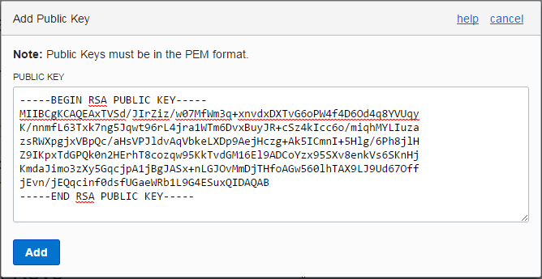
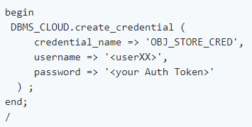
Authentication
IAM service authenticates a Principal by –
User name, Password
You use the password to sign in to the web console
An administrator will provide you with a one-time password when setting up your account
At your first log in, you are prompted to reset the password
API Signing Key
Required when using the OCI API in conjunction with the SDK/CLI
Key is an RSA key pair in the PEM format (min 2048 bits)
In OCI Console, copy and paste the contents of the PEM public key file. Use the private key with the SDK or with your own client to sign your API requests
Auth Tokens
Oracle-generated token strings to authenticate with 3rd party APIs that do no support OCI signature-based authentication (e.g. ADW)
Auth tokens do not expire

Slide 10
Authorization
Authorization specifies various actions an authenticated Principal can perform
OCI Authorization - define specific privileges in policies and associating them with principals
Supports security principle of least privilege; by default, users are not allowed to perform any actions (policies cannot be attached to users, but only groups)
Policies are comprised of one or more statements which specify what groups can access what resources and at what level of access
Policies are written in human-readable format:
Allow group <group_name> to <action> <resource-type> in tenancy
Allow group <group_name> to <action> <resource-type> in compartment <compartment_name> [where <conditions>]
Policy Attachment: Policies can be attached to a compartment or the tenancy. Where you attach it controls who can then modify it or delete it

Slide 11
IAM Policies

Slide 12
Policy Syntax
allow <subject> to <actions> <resource-type> in <placement> where <conditions>
SUBJECT | Type of Access
Group | Both ID & Name
Dynamic Group | Both ID & Name
Service | Only Name
Subjects are a clause for the various ways that an authenticated actor can be addressed:
By membership in a group (e.g., “group Admins”, “group id ocid1.group.c1.....”)
As a service, for OCI Services (e.g., “service objectstorage-br-saopaulo-1”)
As a wildcard, with “Any User” (any request from the tenancy)
More than one name or group can be named in Subjects element. These can be chained by kind (e.g., “group Admins, Readers”)

Slide 13
Policy Syntax
Allow <subject> to <actions> <resource-type> in <placement> where <conditions>
Action | Type of access
inspect | Ability to list resources
read | Includes inspect + ability to get user-specified metadata/actual resource
use | Includes read + ability to work with existing resources (the actions vary by resource type)*
manage | Includes all permissions for the resource
Aggregate resource-type | Individual resource type
all-resources
database-family | db-systems, db-nodes, db-homes, databases
instance-family | instances, instance-images, volume-attachments, console-histories
object-family | buckets, objects
virtual-network-family | vcn, subnet, route-tables, security-lists, dhcp-options, and many more resources (link)
volume-family | volumes, volume-attachments, volume-backups
Cluster-family | clusters, cluster-node-pool, cluster-work-requests
File-family | file-systems, mount-targets, export-sets
dns | dns-zones, dns-records, dns-traffic,..
* In general, this verb does not include the ability to create or delete that type of resource
The IAM Service has no family resource-type, only individual ones

Slide 14
Action
Permssions
API Operation
Actions & Permissions
Volumes-family
INSPECT
VOLUME_INSPECT
READ
MANAGE
ListVolumes
GetVolume
USE
VOLUME_INSPECT
VOLUME_UPDATE
VOLUME_WRITE
READ +
USE +
VOLUME_CREATE
VOLUME_DELETE
CreateVolume
DeleteVolume
When you write a policy giving a group access to a particular action(verb) and resource-type, you're actually giving that group access to one or more predefined permissions
Permissions are the atomic units of authorization that control a user's ability to perform operations on resources
As you go from inspect > read > use > manage, the level of access generally increases, and the permissions granted are cumulative
Each API operation requires the caller to have access to one or more permissions. E.g., to use ListVolumes or GetVolume, you must have access to a single permission: VOLUME_INSPECT
…..
…..

Slide 15
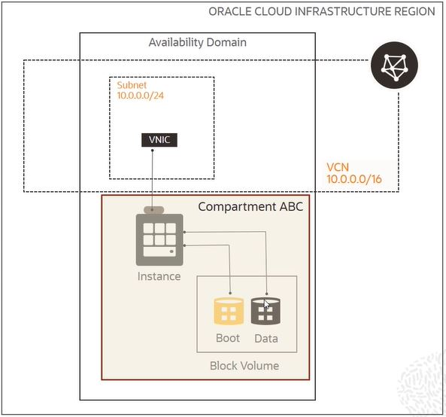
Common Policies
Network Admins manage a cloud network
Allow group NetworkAdmins to manage virtual-network-family in tenancy
Users launch compute instances
Allow group InstanceLaunchers to manage instance-family in compartment ABC Allow group InstanceLaunchers to read app-catalog-listing in tenancy Allow group InstanceLaunchers to use volume-family in compartment ABC Allow group InstanceLaunchers to use virtual-network-family in tenancy
https://docs.cloud.oracle.com/iaas/Content/Identity/Concepts/commonpolicies.htm

Slide 16
Compartments

Slide 17
Compartment
A compartment is a collection of related resources (VCN, instances,..) that can be accessed only by groups that have been given permission (by an administrator in your organization)
Compartments help you organize and control access to your resources
Few design considerations:
Each resource belongs to a single compartment but resources can be connected/shared across compartments (VCN and its subnets can live in different compartments)
A compartment can be deleted after creation or renamed
A compartment can have sub compartments that can be up to six levels deep
Most resources can be moved to a different compartment after they are created (some restrictions apply)
After creating a compartment, you need to write at least one policy for it, otherwise it cannot be accessed (except by administrators or users who have permission to the tenancy)
Sub compartment inherits access permissions from compartments higher up its hierarchy
When you create a policy, you need to specify which compartment to attach it to

Slide 18
When you sign up for OCI
Service Limits
Tenancy
Policy
Root Compartment
Allow group Administrators to manage all-resources in tenancy
Default Administrator
xx.yy@companyABC.com
Groups
Administrators
Oracle sets up a default administrator for the account
Default Group Administrators
Cannot be deleted and there must always be at least one user in it
Any other users placed in the Administrators group will have full access to all of resources
Tenancy Policy gives Administrators group access to all resources – this policy can’t be deleted/changed
Root Compartment can hold all the cloud resources
Best practice is to create dedicated Compartments when you need to isolate resources

Slide 19
Policy Inheritance and Attachment for Compartments

Slide 20
Policy Inheritance
Concept of inheritance: Compartments inherit any policies from their parent compartment
E.g. OCI has a built-in policy for Administrators, Allow group Administrators to manage all-resources in tenancy
Due to Policy Inheritance, the Administrators group can also do anything in any of the compartments in the tenancy
Three levels of compartments: A, B, and C
Policies that apply to resources in Compartment A also apply to resources in Compartments B and C
Allow group NewtworkAdmins to manage virtual-network-family in compartment A allows the group NetworkAdmins to manage VCNs in Compartment A, B, and C
Tenancy (root compartment)
A
B
C

Slide 21
Policy Attachment
Concept of attachment: when you create a policy you must attach it to a compartment (or tenancy). Where you attach it controls who can then modify it or delete it
Attach it to tenancy (root compartment), then anyone with access to manage policies in the tenancy can then change or delete it.
Attach to a child compartment, then anyone with access to manage the policies in that compartment (e.g. compartment admins) can change or delete it
Tenancy (root compartment)
You want to create a policy to allow NetworkAdmins to manage VCNs in Compartment C. Attach to
C or B – Allow group NewtworkAdmins to manage virtual-network-family in compartment C
A – Allow group NewtworkAdmins to manage virtual-network-family in compartment B:C
Only Compartment A admins can modify it
NetworkAdmins can still only manage VCNs in CompartmentC
Tenancy – Allow group NewtworkAdmins to manage virtual-network-family in compartment A:B:C
A
B
C

Slide 22
Tags

Slide 23
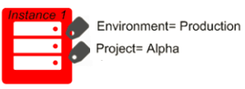
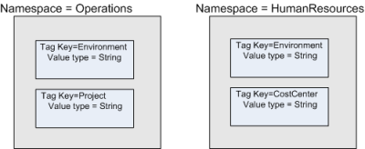
Tagging
Free-form Tags – basic implementation
Consist simply of a key and a value
Defined Tags – more features and control
Are contained in tag Namespaces
Defined schema, secured with Policy

Slide 24
Tag Namespace
A Tag Namespace is a container for set of tag keys with tag key definitions
Tag key definition specifies its key (environment) and what types of values are allowed (string, number, text, date, enumerations, etc.)
Namespace Definition: Operations
Key Definition: Environment
Tag
Operations.Environment = “Production”
Namespace
Key
Value
Tag key definition or a tag namespace cannot be deleted, but retired. Retired tag namespaces and key definitions can no longer be applied to resources
You can reactivate a tag namespace or tag key definition that has been retired to reinstate its usage in your tenancy

Slide 25
Working with defined tags
Consist of a tag namespace, a key, and a value
Tag namespace and tag key definition must be set up in your tenancy before users can apply them
A tag key can have either a tag value type of string or a list of values (from which the user must choose)
You can use a variable to set the value of a tag. When you add the tag to a resource, the variable resolves to the data it represent. E.g.
Operations.CostCenter = ${iam.principal.name} at ${oci.datetime}
Operations is the namespace, CostCenter is the tag key, and the tag value contains two tag variables ${iam.principal.name} and ${oci.datetime}
When you add this tag to a resource, the variable resolves to your user name (the name of the principal that applied the tag) and a time date stamp for when you added the tag

Slide 26

Tag-based Access Control
TBAC Tag-based Access Control allows to define policies with tags that span compartments, groups and resources
Scope access based on the tags applied to a resource
TBAC = conditions + set of tag variables
Access can be controlled based on a tag
On the requesting resource (group, dynamic group or compartment)
On the target of the request (resource or compartment

Slide 27
Tag-based Access Control
Tag applied to requestor | Variable | Sample Policy
Group | request.principal.group.tag.{tagNamespace}.{tagKeyDefinition}=‘<value>’ | allow any-user to manage instances in compartment HR where request.principal.group.tag.Operations.Projetct=‘PROD’
Dynamic Group | request.principal.group.tag.{tagNamespace}.{tagKeyDefinition}=‘<value>’ | allow dynamic-group InstancesA to manage object-family in compartment HR where request.principal.group.tag.Operations.Project=‘PROD’
Compartment | request.principal.compartment.tag.{tagNamespace}.{tagKeyDefinition}=‘<value>’ | allow dynamic-group InstancesA to manage object-family in compartment HR where request.principal.compartment.tag.Operations.Project=‘PROD’

Slide 28
Tag-based Access Control
Tag applied to target | Variable | Sample Policy
Resource | target.resource.tag.{tagNamespace}.{tagKeyDefinition}=‘<value>’ | allow group groupA to manage all-resources in compartment HR where target.resource.tag.Operations.Project=‘PRD’
Compartment | target.resource.compartment.tag.{tagNamespace}.{tagKeyDefinition}=‘<value>’ | allow group groupA to manage all-resources in compartment HR where target.resource.compartment.tag.Operations.Project=‘PRD’

Slide 29
Multifactor Authentication (MFA)

Slide 30
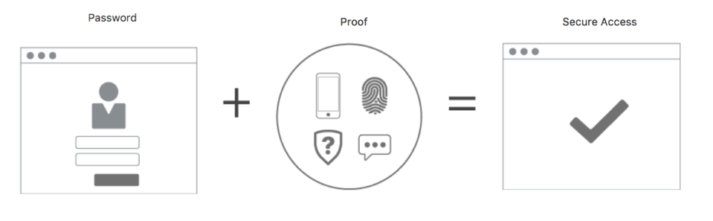
Multi-factor Authentication (MFA) - General Concepts
Multi-factor authentication (MFA) is a method of authentication that requires the use of more than one factor to verify a user’s identity. Examples of authentication factors are a password (something you know) and a device (something you have).
Notes:
MULTI-FACTOR AUTHENTICATION (MFA)
Multi-factor authentication (MFA) is a method of authentication that requires the use of more than one factor to verify a user’s identity. Examples of authentication factors are a password (something you know) and a device (something you have).
AUTHENTICATOR APP
An app you install on your mobile device that can provide software-based secure tokens for identity verification. Examples of authenticator apps are Oracle Mobile Authenticator and Google Authenticator. To enable MFA for the IAM service, you'll need a device with an authenticator app installed. You'll use the app to register your device and then you'll use the same app (on the same device) to generate a time-based one-time passcode every time you sign in.
REGISTERED MOBILE DEVICE
Multi-factor authentication is enabled for a specific user and for a specific device. The procedure to enable MFA for a user includes the registration of the mobile device. This same device must be used to generate the time-based one-time passcode every time the user signs in. If the registered mobile device becomes unavailable, an administrator must disable MFA for the user so that MFA can be re-enabled with a new device.
TIME-BASED ONE-TIME PASSWORD (TOTP)
A TOTP is a password (or passcode) that is generated by an algorithm that computes a one-time password from a shared secret key and the current time, as defined in RFC 6238. The authenticator app on your registered mobile device generates the TOTP that you need to enter every time you sign in to Oracle Cloud Infrastructure.

Slide 31
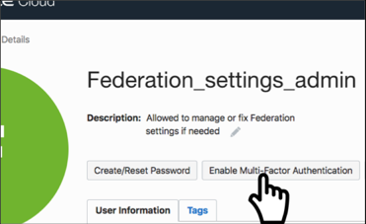
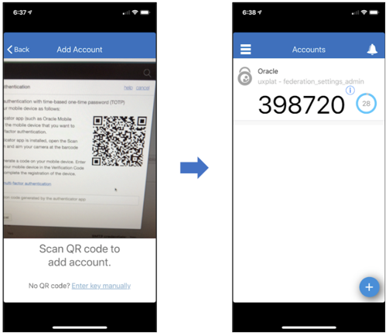
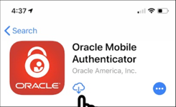
Multi-factor Authentication (MFA) - How to enable?
Step 1
Step 3
Step 2
Notes:
Each user must enable MFA for themselves using a device they will have access to every time they sign in. An administrator cannot enable MFA for another user.
You must install a supported authenticator app on the mobile device you intend to register for MFA.
To enable MFA, you use your mobile device's authenticator app to scan a QR code that is generated by the IAM service and displayed in the Console. The QR code shares a secret key with the app to enable the app to generate TOTPs that can be verified by the IAM service. A user can register only one device to use for MFA.
After you add your Oracle Cloud Infrastructure account to your authenticator app, the account name displays in the authenticator app as Oracle <tenancy_name> - <username>.

Slide 32
Advanced IAM Policies

Slide 33
Advanced Policy Syntax
As part of a policy statement, you can specify one or more conditions that must be met to get access
Allow <subject> to <action> <resource-type> in <placement> where <conditions>
You use variables when adding conditions to a policy; 2 types
request – relevant to the request itself
target – relevant to the resource(s) being acted upon in the request)
E.g. variable request.operation represents the API operation being requested (e.g. ListUsers); target.group.name represents the name of the group
variable name is prefixed accordingly with either request or target followed by a period
Examples:
Allow group Phoenix-Admins to manage all-resources in tenancy where request.region='phx'
https://docs.cloud.oracle.com/iaas/Content/Identity/Reference/policyreference.htm#Resource

Slide 34
Policy Syntax
Allow <subject> to <verb> <resource-type> in <location> where <conditions>
Conditions:
Syntax for a single condition: variable =|!= value
request.operation | The API operation name being requested
request.permission | The underlying permission(s) requested
request.user.id | OCID of the requesting user
request.groups.id | The OCIDs of groups requesting user is in
target.compartment.id | The OCID of the compartment
target.compartment.name | The name of the compartment specified in target.compartment.id
request.region | The key of the region the request is made in
request.ad | The name of the AD the request is made in
2 variable types: request (relevant to the request itself), and target (relevant to the resource(s) being acted upon in the request)
E.g. variable request.operation represents the API operation being requested (e.g. ListUsers); target.group.name represents the name of the group
variable name is prefixed accordingly with either request or target followed by a period
Example: Allow group Phoenix-Admins to manage all-resources in tenancy where request.region='phx'

Slide 35
Policy Syntax
Allow <subject> to <verb> <resource-type> in <location> where <conditions>
Conditions: Syntax for a single condition: variable =|!= value
Type | Types of value
String | (single quotation marks are required around the value)
Pattern | /HR*/ (matches strings that start with "HR") /*HR/ (matches strings that end with "HR") /*HR*/ (matches strings with "HR")
Syntax for multiple conditions: any|all {<condition>,<condition>,...}
Allow group XYZ to manage groups in tenancy where any {request.operation='ListGroups’, request.operation='GetGroup’,
request.operation='CreateGroup’, request.operation='UpdateGroup'}
Allow group XYZ to manage groups in tenancy where all {request.permission='GROUP_INSPECT’, request.operation='ListGroups'}

Slide 36
Advanced Policy
Policy for GroupAdmins group to manage any groups with names that start with "A-Users-"
Allow group GroupAdmins to manage groups in tenancy where target.group.name = /A-Users-*/
Policy for GroupAdmins group to manage the membership of any group besides the Administrators group:
Allow group GroupAdmins to use users in tenancy where target.group.name != 'Administrators'
Policy lets A-Admins create, update, or delete any groups whose names start with "A-", except for the A-Admins group itself
Allow group GroupAdmins to manage groups in tenancy where all {target.group.name=/A-*/,target.group.name!='A-Admins'}

Slide 37
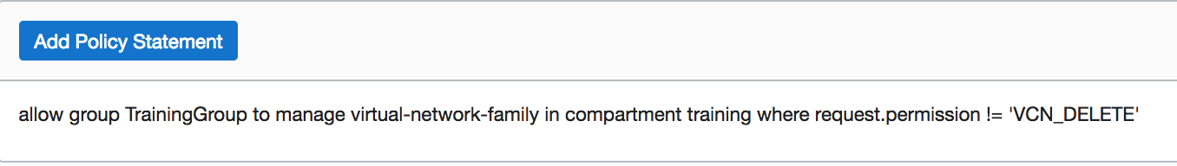
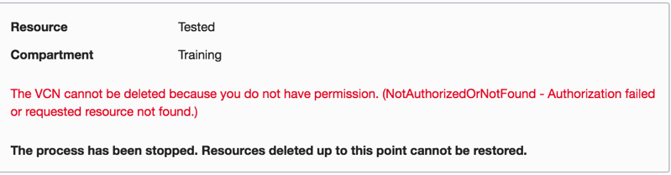
Scoping Access with Permissions or API Operations
In a policy statement, you can use conditions combined with permissions or API operations to reduce the scope of access granted by a particular verb.
Allow a user to manage VCN resources except have the ability to delete a VCN
allow group TrainingGroup to manage virtual-network-family in compartment training where request.permission != 'VCN_DELETE’

Slide 38
Identity Federation

Slide 39
Best Practices for securing IAM – IAM Federation
Oracle recommends that you use federation to manage logins into the Console
An administrator needs to set up a federation trust between the on-premises identity provider (IdP) and IAM, in addition to creating mapping between on-premises groups and IAM groups
Federation is especially important for enterprises using custom policies for user authentication (for example, multifactor authentication).
When using federation, Oracle recommends that you create a federation administrators group that maps to the federated IdP administrator group
The federation administrators group will have administrative privileges to manage customer tenancy, while being governed by the same security policies as the federated IdP administrator group
In this scenario, it is a good idea to have access to the local tenancy administrator user (that is, member of the default tenancy administrator IAM group), to handle any break-glass type scenarios (for example, inability to access resources through federation)
Tenancies federated with Oracle Identity Cloud Service or Okta, can leverage SCIM (System for Cross-domain Identity Management). Such users can have the additional credentials such as API keys and auth tokens that are managed in the User Settings page.

Slide 40
Experience for Federated Users
Federated users can use the Console to access Oracle Cloud Infrastructure (according to IAM policies for the groups the users are in).
They'll be prompted to enter their Oracle Cloud Infrastructure tenant (for example, ABCCorp).
They then see a page with two sets of sign-in instructions: one for federated users and one for non-federated (Oracle Cloud Infrastructure) users.

Slide 41
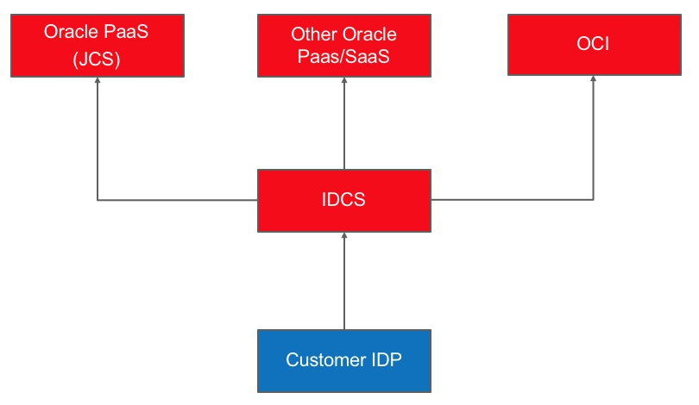
Federation with IDCS - Recommended
Notes:
Tenancies created December 21, 2018 and after are automatically federated with Oracle Identity Cloud Service and configured to provision federated users in OCI.
Oracle Cloud Infrastructure tenancies created between December 18, 2017 and December 20, 2018 are automatically federated with Oracle Identity Cloud Service. but are not configured to provision federated users in Oracle Cloud Infrastructure to allow these users to have additional credentials (API keys, auth tokens, etc.). To enable this feature for users, you need to perform a one-time upgrade
Oracle Identity Cloud Service is the identity provider for multiple Oracle services. Federating Oracle Cloud Infrastructure with Oracle Identity Cloud Service allows you to have a seamless connection between services, without having to create a separate username and password for each one.

Slide 42
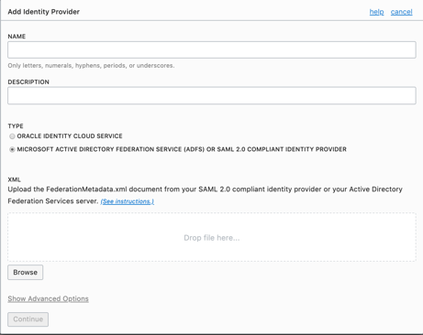
Federation with Microsoft Active Directory
Get required information from Active Directory Federation Services.
Federate Active Directory with Oracle Cloud Infrastructure:
Add the identity provider (AD FS) to your tenancy and provide the required information.
Map Active Directory groups to IAM groups.
In Active Directory Federation Services, add Oracle Cloud Infrastructure as a trusted, relying party.
In Active Directory Federation Services, add the claim rules required in the authentication response by Oracle Cloud Infrastructure.
Test your configuration by logging in to Oracle Cloud Infrastructure with your Active Directory credentials.
https://docs.cloud.oracle.com/iaas/Content/Identity/Tasks/federatingADFS.htm

Slide 43
Federation with Microsoft Azure Active Directory
In Oracle Cloud Infrastructure, download the federation metadata document.
In Azure AD, set up Oracle Cloud Infrastructure Console as an enterprise application.
In Azure AD, configure the Oracle Cloud Infrastructure enterprise application for single sign-on.
In Azure AD, set up the user attributes and claims.
In Azure AD, assign user groups to the application.
In Azure AD, download the Azure AD SAML metadata document.
In Oracle Cloud Infrastructure, set up Azure AD as an identity provider.
In Oracle Cloud Infrastructure, map your Azure AD groups to Oracle Cloud Infrastructure groups.
In Oracle Cloud Infrastructure, set up the IAM policies to govern access for your Azure AD groups.
Share the Oracle Cloud Infrastructure sign-in URL with your users.
https://docs.cloud.oracle.com/iaas/Content/Identity/Tasks/federatingADFSazure.htm

Slide 44
Reference IAM Model: Authentication and user management
All access by humans go through federation with a customer's corporate identity provider (IdP) to leverage their proven Auth mechanisms (MFA) and management capabilities (password complexity/rotation)
Use case | Feature
Human using console | Use SAML2.0 federation between corporate IdP and OCI IAM
Human using the CLI/SDK | Create a federated user with SCIM or an OCI IAM user with an API signing key
Human using a PaaS/SaaS app | Use SAML2.0 federation between corporate IdP and OCI IAM
Code running in OCI that calls OCI native APIs | Use Instance Principals
Code running outside OCI that calls OCI APIs | Create an OCI IAM "user" with an API signing key. The "user" in this case represents a software agent, not a human
"Break-glass" access by a human when federation fails | Create an OCI IAM user in the default Admins group Set a random Console password of sufficient length/complexity Store this password in a software password manager or physical safe Password is for infrequent use and should not be human memorizable Use once – rotate password after every use Monitor via Audit Service Alarm on any use or attempted use of "break-glass" user Outside the "break-glass" scenario, there is no reason to have an OCI IAM user with a Console password

Slide 45
Reference IAM model for Enterprises

Slide 46
Compartments
A compartment is a collection of related resources (VCN, instances,..) that can be accessed only by groups that have been given permission (by an administrator in your organization)
Compartments help you organize and control access to your resources
Design considerations:
When creating a resource (for example, instance, block storage volume, VCN, subnet), you must decide in which compartment to put it.
Compartments are logical, not physical, so related resource components can be placed in different compartments.
You can create a hierarchy of compartments up to six compartments deep under the tenancy (root compartment).
When you write a policy rule to grant a group of users access to a resource, you always specify the compartment to apply the access rule to. So if you choose to distribute resources across compartments, remember that you will need to provide the appropriate permissions for each compartment for users that will need access to those resources.
If you want to delete a compartment, you must delete all resources in the compartment first.

Slide 47
Moving a Compartment to a Different Parent Compartment
Be aware of following complications before you move a compartment:
Required IAM Policy
Understanding the Policy Implications When You Move a Compartment
Understanding Compartment Quota Implications When You Move a Compartment
Understanding Tagging Implications When You Move a Compartment

Slide 48
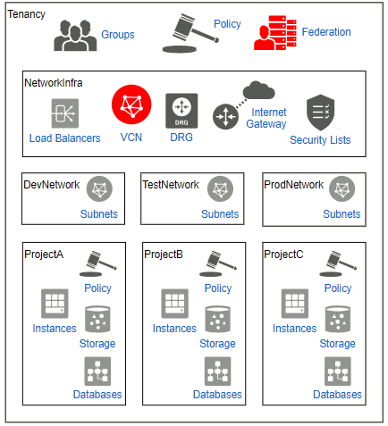
Reference IAM Model: Compartments
Compartment: NetworkInfra
Critical network infrastructure that should be centrally managed by network admins
Resources: Security Lists, Internet Gateways, DRGs, the top-level VCN(s), etc.
Compartment: ProdNetwork
Production environment that may or may not be centrally managed but is typically under change management
Modeled as a separate compartment to easily write policy about who can use (i.e. attach resources to) the network
Optionally Databases and Storage may be included here depending on whether they are shared resources or not
Resources: Subnets, (Databases), (File Storage)

Slide 49
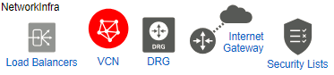

Reference IAM Model: Compartments
Tenancy
Groups
NetworkAdmins (John)
Groups
A-Admins (Tom)
ProjectA
Allow group NetworkAdmins to MANAGE virtual-network-family in compartment NetworkInfra
Allow group NetworkAdmins to manage instance-family in compartment NetworkInfra
Allow group A-Admins to USE virtual-network-family in compartment NetworkInfra
Allow group A-Admins to manage all-resources in compartment ProjectA
John creates a Network in NetworkInfra compartment
John can't terminate, reboot or launch new instances into ProjectA compartment
Tom launches instances in ProjectA using the VCN in NetworkInfra compartment
Tom cannot launch instance inside the NetworkInfra compartment
The instances Tom launched reside in the VCN from a network topology standpoint but from an access standpoint, they're in the ProjectA compartment, not the NetworkInfra compartment where the VCN is

Slide 50
Wrap-Up You should now be familiar with:
Advanced Policy Syntax
Multi-factor Authentication
Federating OCI with Oracle Identity Cloud Service (IDCS)
Federating OCI with Microsoft Active Directory
Federating OCI with Microsoft Azure Active Directory
Reference IAM model
Compartments design
Example IAM compartment and policy design

Slide 51


Feedback/Comments/Ask for help
alexandre.af.fagundes@oracle.com

